Slide 1

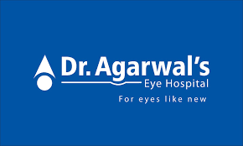
YOUR healthcare OFFICE solution
Dr. Agarwal's Eye Hospital
Proposed By Kamalesh K

Slide 2

OUR BIG IDEA
Prepare the best ad plan for the healthcare industry with the suggested budgets. Healthcare websites should be promoted across India. Include the average CPC, Cost/Conversions, and leads expected.

Slide 3

TABLE OF CONTENT
01.Market research
02.THE MARKET analysis
03. SERVICES
04. Swot analysis FOR DR AGARWAL
05. MAJOR COMPETITORS
06. Swot analysis for competitor
07. Marketing Mix - The 7P's of Marketing
08. Improvements in Marketing Mix - The 7P's of Marketing
09. DETAILED SEO & SEM Audit
*Monthly domain overview
*Competitive Analysis & Action Plan for Dr. Agarwal’s Website
*top organic competitors
* top ad competitors
* Paid Keyword Market Analysis
10. Operating locations / Geographic segmentation
11. Keyword research
12. Search engine Marketing
13. Social media marketing
14. Influencer marketing
15. Influencer endorsements
16. Email marketing
17.CONTENT CALENDAR 18.Monthly Website Promotion Budget

Slide 4
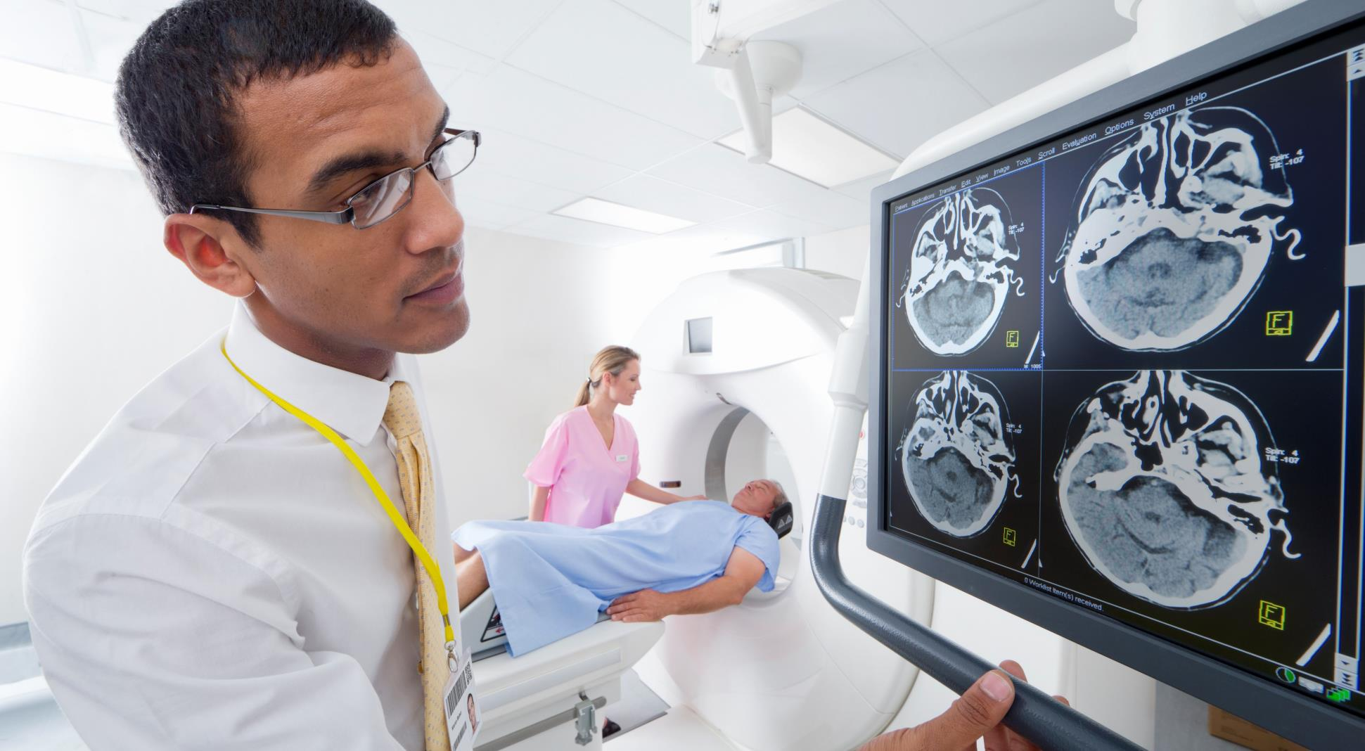





Market research
33%
$71.19
40-60%
$50,000
5%
Average Indian Population Who Visit Ophthalmologists Regularly*
Eyecare Spending
Average Profit Margin
Average Annual Revenue per Doctor
Market Growth Per Year
Success

Slide 5
THE MARKET
ANALYSIS
22%
45%
38%
10%
8%
Ophthalmologist
Optometrist
Optician
Orthoptist
Emergency
Services | YR 1 | GROWTH | YR 2 | YR 3
Ophthalmologist | 20-30 lakhs | 10% | 22-33 lakhs | 24.2-36.3 lakhs
Optometrist | 6-8 lakhs | 8% | 6.4-8.6 lakhs | 7-9.3 lakhs
Optician | 3-4 lakhs | 10% | 3.3-4.4 lakhs | 3.6-4.8 lakhs
Orthoptist | 3-8 lakhs | 7% | 3.2-8.6 lakhs | 3.5-9.2 lakhs
Emergency | 2-4 lakhs | 5% | 2.1-4.2 lakhs | 2.2-4.4 lakhs
TOTAL | 34-54 lakhs |  | 37-58.8 lakhs | 40-64 lakhs

Slide 6
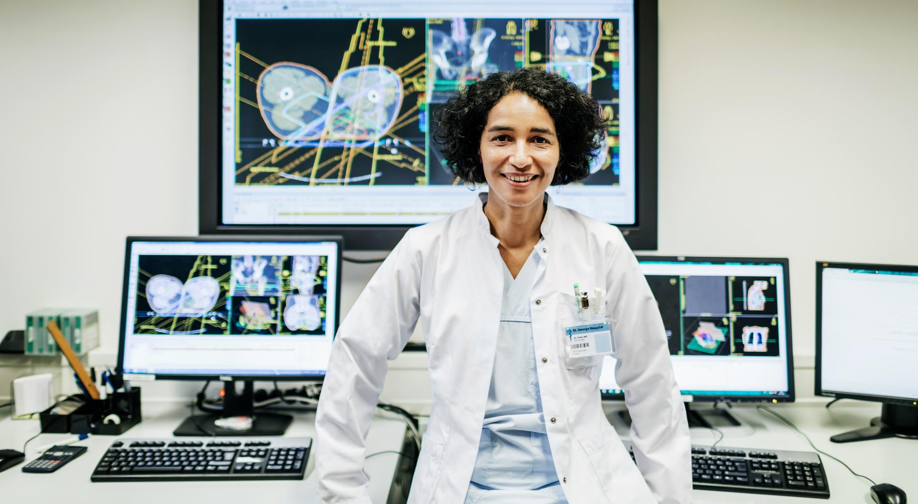
SERVICES
Extended Office Hours
Eye Treatments and Surgery
In-house Specialist
Mon - Sat : 9:00AM to 8:00PM
Extensive Network
Surplus Medical Supplies

Slide 7
Swot analysis FOR DR AGARWAL
Dr Agarwal Hospital
🟢 Strengths: ❤ Strong brand with 193+ centers in India & Africa ❤ Comprehensive eye care services (cataract, LASIK, opticals, etc.) ❤ Healthy financials with stable growth & strong profitability ❤ High patient trust & strong market presence
🟡 Opportunities: 💯 Growing demand due to rising health awareness 💯 ₹600 crore investment to expand to 200 hospitals 💯 Increasing use of advanced eye care technology 💯 Potential for tie-ups with insurance & corporate health programs
🔴 Weaknesses: 🚫 High dependence on skilled ophthalmologists 🚫 Geographic concentration (50% centers in Tamil Nadu & Maharashtra) 🚫 Expansion challenges in new regions 🚫 Limited government collaborations compared to competitors
⚫ Threats: 🆘 Intense competition from private & government hospitals 🆘 High costs of maintaining advanced medical equipment 🆘 Challenges in hiring & retaining top ophthalmologists 🆘 Risk of economic downturn affecting patient spending

Slide 8
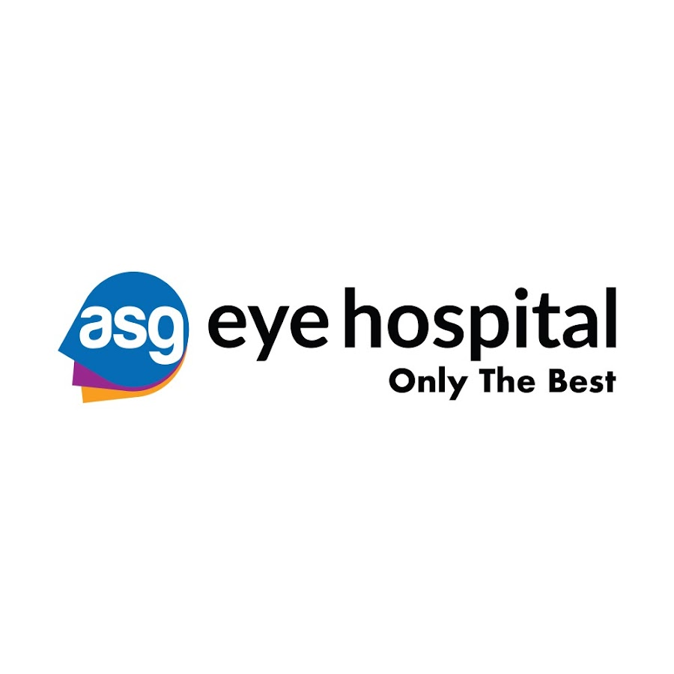
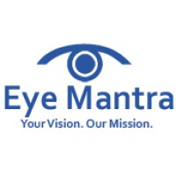

MAJOR COMPETITORS
ASG Eye Hospital Started practicing in 2002. Main market is primarily business executives in the downtown financial district. Not very competitive on pricing. Standard business hours from 9:00AM to 5:00PM Mon-Fri.
Eye Mantra Hospital Started practicing in 2005. Very innovative in technology and service offerings. Pricing standard to market. Practices pediatrics as well as general dentistry. Offers a “kids’ corner” for parents.
Center For Sight Chain company. Standard hours. Reviews reveal customer service is lacking. Main target market is geared towards seniors and office specializes in dental implants and surgeries.

Slide 9
Swot analysis for competitor
Ags Eye Hospital
Eye Mantra
Center for sight
🟢 Strengths: ❤ 160+ hospitals in 83+ cities across India, Nepal & Uganda ❤ ₹1,500 crore investment from General Atlantic & Kedaara Capital ❤ Offers a full range of eye treatments (Cataract, LASIK, Retina, Glaucoma, etc.) ❤ Strong leadership with experienced ophthalmologists & specialists ❤ Rapid expansion & strong brand recognition in the eye care industry
🟢 Strengths: ❤ Wide range of eye care services (Cataract, LASIK, Retina, Glaucoma, etc.) ❤ Led by experienced doctors like Dr. Shweta Jain ❤ Uses advanced technology from Zeiss & Topcon for precise treatments ❤ Patient-centric approach with personalized care & positive reviews ❤ Accredited by NABH & ISO 9001, ensuring quality & safety
🟢 Strengths: ❤ 85+ centers across 30+ cities, ensuring wide accessibility ❤ 28+ years of experience in delivering top-quality eye care ❤ Offers advanced treatments like LASIK, cataract, retina, and glaucoma care ❤ Recognized as one of Delhi’s most trusted eye hospitals (Reader’s Digest, 2023) ❤ Founded by Padma Shri awardee Dr. Mahipal S Sachdev, ensuring expert leadership

Slide 10
🔴 Weaknesses: 🚫 Challenges in integrating acquired hospitals like Vasan Eye Care 🚫 High dependence on skilled ophthalmologists & trained medical staff 🚫 Managing a vast network leads to operational & administrative complexities 🚫 Inconsistent patient inflow in certain regions affects resource planning 🚫 Need for continuous investment in infrastructure & technology
🔴 Weaknesses: 🚫 Limited presence, mainly in Delhi & nearby areas 🚫 Dependence on key doctors for high-quality treatments 🚫 Some staff-related concerns in employee reviews 🚫 Scaling operations while maintaining service quality can be challenging 🚫 Competes with more recognized eye hospital chains
🔴 Weaknesses: 🚫 Patient experience varies at different centers, affecting brand perception 🚫 Managing a large network leads to operational & administrative challenges 🚫 High dependence on experienced doctors for maintaining service quality 🚫 Consistency in service & infrastructure needs continuous investment 🚫 Requires ongoing upgrades to keep pace with advancements in eye care technology
🟡 Opportunities: 💯 Expanding into western & southern India to capture new markets 💯 Increasing demand for specialized eye care in Tier 2 & Tier 3 cities 💯 Adoption of cutting-edge technologies to enhance treatment outcomes 💯 Potential tie-ups with insurance companies & corporate health programs 💯 Growing awareness about eye health & preventive care boosts patient inflow
🟡 Opportunities: 💯 Expansion into other major cities to increase reach & patient base 💯 Adoption of cutting-edge technology for better treatment outcomes 💯 Partnerships with insurance & corporate health programs 💯 Community outreach & awareness campaigns to attract more patients 💯 Introducing new specialties to diversify services
🟡 Opportunities: 💯 Expansion into more Tier 2 & Tier 3 cities to grow patient reach 💯 Adoption of AI & robotic-assisted eye surgeries to enhance precision 💯 Corporate tie-ups & insurance collaborations to increase accessibility 💯 Implementing telemedicine services for virtual consultations & follow-ups 💯 Community outreach programs to spread awareness on eye health
⚫ Threats: 🆘 Intense competition from both private & government eye hospitals 🆘 Economic fluctuations may impact patient spending on elective surgeries 🆘 Changing healthcare policies & regulatory challenges 🆘 Rising costs of maintaining advanced medical equipment & technology 🆘 Difficulty in hiring & retaining top-tier ophthalmologists
⚫ Threats: 🆘 High competition from well-established eye hospitals 🆘 Economic downturns may reduce demand for elective procedures 🆘 Changing healthcare regulations could impact costs & operations 🆘 Need for continuous investment in technology to stay competitive 🆘 Health crises (e.g., pandemics) can disrupt patient visits & services
⚫ Threats: 🆘 Strong competition from other established eye hospitals & healthcare chains 🆘 Economic downturns may reduce demand for premium eye treatments 🆘 Changing healthcare regulations could impact operational costs & compliance 🆘 Public health crises (e.g., pandemics) can disrupt patient visits & revenue 🆘 Need for constant technological investment to stay competitive

Slide 11
Marketing Mix - The 7P's of Marketing
1. Product: The hospital offers a wide range of ophthalmic services, including treatments for cataracts, glaucoma, retinal disorders, LASIK surgeries, and pediatric ophthalmology. They are known for pioneering surgical techniques like Macro-Phakonit and Glued IOL, reflecting their commitment to innovation in eye care.
2. Price: Dr. Agarwal's Eye Hospital provides various pricing options to cater to different patient needs. They offer promotions such as 15% off on optical purchases and 50% off on comprehensive eye tests, making eye care more accessible. ​
3. Place: With over 180 centers across India and 15 internationally, including multiple locations in Coimbatore like RS Puram, the hospital ensures widespread accessibility. This extensive network allows patients to access their services conveniently.

Slide 12
4. Promotion: The hospital engages in various promotional activities, including collaborations with renowned personalities like Sachin Tendulkar and Glenn McGrath to raise awareness about eye health. They also offer free eye check-ups for individuals over 50 and discounts for others, encouraging regular eye examinations.
5. People: Dr. Agarwal's boasts a team of over 400 eye-care professionals dedicated to patient care and continuous research. Notable specialists include Dr. Jayshree Arunaprakash, Head of Clinical Services in Coimbatore, specializing in cataract and retinal treatments.
6. Process: The hospital emphasizes a patient-centric approach, utilizing advanced technologies and innovative surgical techniques to enhance treatment outcomes. Their processes are designed to ensure efficiency and high-quality care

Slide 13
7. Physical Evidence: Dr. Agarwal's facilities are equipped with state-of-the-art technology, providing a comfortable environment for patients. Their numerous centers serve as tangible proof of their established presence in the healthcare sector.
Through this strategic blend of the 7Ps, Dr. Agarwal's Eye Hospital effectively addresses patient needs and reinforces its position as a leader in eye care services.
Improvements in Marketing Mix - The 7P's of Marketing
1. Product – Expand & Differentiate Services
Introduce AI-based eye diagnostics for early detection of conditions like diabetic retinopathy.
Offer customized LASIK packages with financing options to attract younger demographics.
Launch home-based eye checkups for elderly patients who have mobility issues.

Slide 14
2. Price – Flexible & Transparent Pricing
Implement a tiered pricing model for different income groups, ensuring accessibility.
Provide a subscription-based model for long-term eye care, including routine checkups.
Clearly display costs on the website to enhance transparency and trust.
4. Promotion – Strengthen Digital & Influencer Marketing
Boost social media engagement with patient success stories and educational content.
Use targeted ads on Google & Meta to reach high-risk groups (e.g., diabetics for retinopathy screenings).
Collaborate with health influencers & doctors to build credibility.
Offer loyalty rewards for regular eye check-ups and referrals.
3. Place – Improve Accessibility
Expand mobile eye clinics in rural and underserved areas.
Partner with corporate offices & schools to provide on-site eye checkups.
Enhance teleconsultation services with AI-powered preliminary screenings.
5. People – Enhance Training & Patient Experience
Provide specialized training for staff on handling senior citizens and children.
Introduce a "Patient Care Concierge" to assist first-time visitors.
Gather real-time feedback from patients via digital surveys and act on it.

Slide 15
6. Process – Improve Patient Experience
Reduce wait times by integrating AI-powered appointment scheduling.
Offer a one-stop consultation process, where diagnostics and prescriptions happen in a single visit.
Provide WhatsApp-based follow-ups to ensure post-treatment care adherence.
7. Physical Evidence – Modernize Infrastructure
Improve clinic aesthetics with soothing interiors and digital screens for education.
Offer VR-based consultation previews for procedures like LASIK, helping patients understand their treatment better.
Introduce eco-friendly measures like paperless records and sustainable infrastructure.
Overall Strategy
These changes will: ✔ Attract a wider patient base ✔ Improve patient experience ✔ Enhance brand trust & visibility

Slide 16
DETAILED SEO & SEM Audit
Dr Agarwals - Best Eye Hospital In India | Eye Disease Treatment
TITLE
64 characters
DESCRIPTION
151 characters
Dr Agarwals eye hospital with best eye specialist and 220+ hospitals in India providing best eye disease treatment since 1957. Book an appointment now!
https://www.dragarwal.com/
URL
https://www.dragarwal.com/
CANONICAL
index, follow, max-image-preview:large, max-snippet:-1, max-video-preview:-1
META ROBOTS
CLS
0.01
INDEXABLE
INP
360ms
LCP
1.4s
WEB VITALS
INSIGHTS
Title characters should be less than 60 or else it will truncate
Pimary keyword is used in both title and description

Slide 17
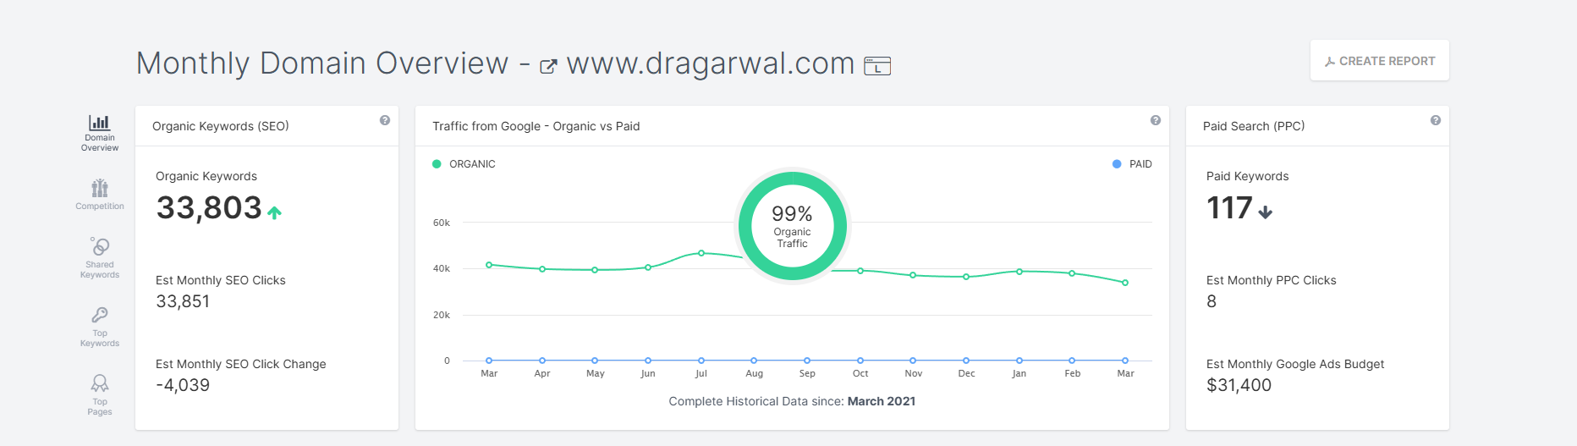
Analysis & Suggested Improvements for Dr. Agarwal’s Website SEO & PPC Performance
Key Insights from the Report:
Organic Keywords: 33,803 (increasing)
Estimated Monthly SEO Clicks: 33,851 (decreasing by 4,039 clicks)
Organic vs. Paid Traffic: 99% of traffic is from organic search
Paid Keywords: 117 (decreasing)
Estimated Monthly PPC Clicks: 8
Estimated Google Ads Budget: $31,400
Areas for Improvement & Strategies
1. Recover & Boost Organic Clicks
Problem: A drop of 4,039 SEO clicks despite high organic keyword rankings.
Solutions:
Improve CTR: Optimize meta titles & descriptions to attract more clicks.
Target High-Intent Keywords: Focus on ranking for transactional keywords rather than just informational ones.
Improve Internal Linking: Strengthen internal links to important pages for better authority distribution.
Technical SEO Fixes: Check for indexing issues, page load speed, and mobile usability.

Slide 18
2. Increase Conversions from Organic Traffic
Problem: High organic traffic but low conversion rate.
Solutions:
Optimize landing pages with clear CTAs, testimonials, and easy appointment booking.
Add schema markup for rich results (e.g., FAQs, reviews, and medical services).
Improve user experience with faster page load times and mobile-friendly design
4. Balance Organic & Paid Strategy
Since 99% of traffic is organic, investing more in paid ads could drive immediate results. However, improving PPC efficiency is crucial before increasing the budget.
3. Improve PPC Performance
Problem: High ad budget ($31,400) but very low estimated PPC clicks (8).
Solutions:
Optimize Ad Copy: Use more compelling ad headlines and descriptions.
Improve Keyword Targeting: Focus on high-converting keywords instead of broad ones.
Landing Page Optimization: Ensure ad clicks land on relevant pages with strong CTAs.
A/B Testing: Test different ad creatives and landing pages to increase conversion rates.

Slide 19
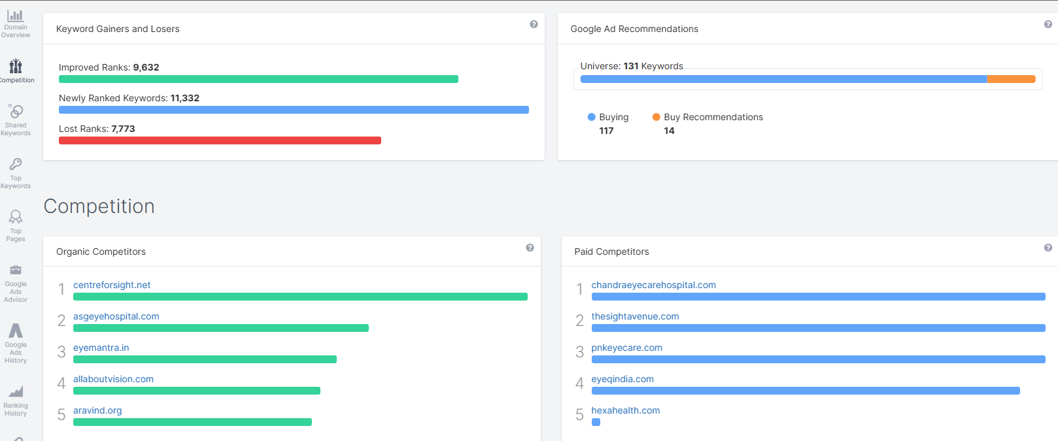
Competitive Analysis & Action Plan for Dr. Agarwal’s Website
1. Keyword Gains & Losses Analysis
Improved Ranks: 9,632 keywords
Newly Ranked Keywords: 11,332 keywords
Lost Ranks: 7,773 keywords
Improvements Needed: ✅ Focus on retaining and improving ranking for lost keywords. ✅ Identify high-traffic lost keywords and create updated content around them. ✅ Optimize existing pages to regain lost rankings with better keyword targeting.
2. Organic & Paid Competitors Analysis
Top Organic Competitors:
centreforsight.net 2.asgeyehospital.com
3.eyemantra.in 4.allaboutvision.com 5. aravind.org
🔍 PPC Strategy Improvements:
Analyze competitors’ ad copies to improve CTR.
Target high-intent keywords with better ad copy and landing page experience.
Reduce wasted ad spend by refining targeting options.
Increase PPC budget efficiency by improving ad quality scores.

Slide 20
3. Google Ads Recommendations
Buying Keywords: 117
Buy Recommendations: 14
✅ Action Plan:
Evaluate the suggested keywords and add relevant ones to the PPC campaign.
Remove underperforming paid keywords to optimize budget allocation.
A/B test ad creatives for better conversions.
Final Recommendations:
SEO: Recover lost rankings with optimized pages & backlink strategies.
Content Strategy: Improve keyword relevance & topic authority with high-quality content.
PPC: Optimize budget usage and ad targeting for higher conversions.
Competitor Monitoring: Track and adapt strategies based on top competitors.

Slide 21
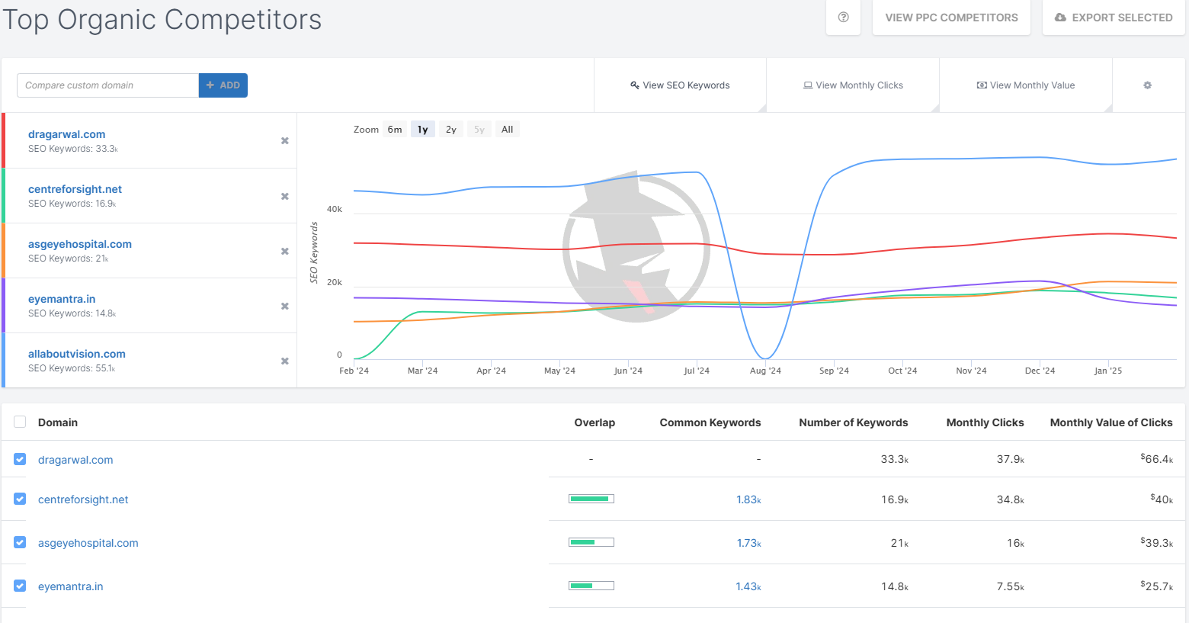
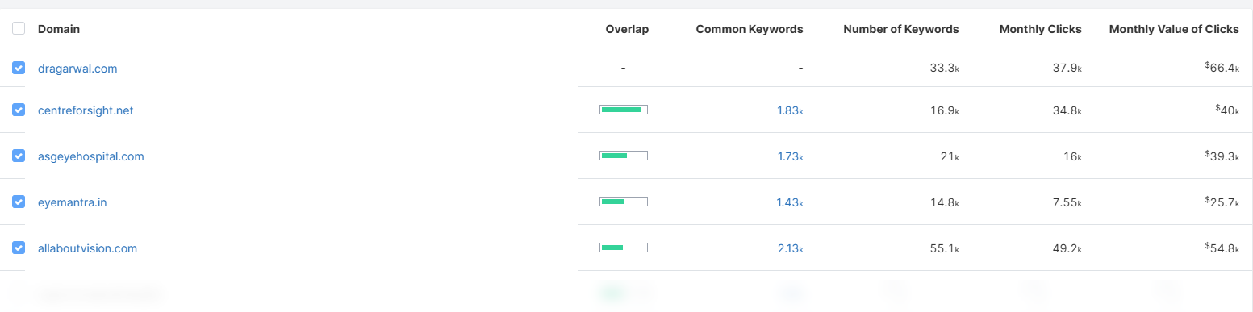

Slide 22
🧠 Key Observations
1. Current SEO Performance (dragarwal.com):
SEO Keywords: 33.3k
Monthly Clicks: 37.9k
Monthly Value of Clicks: $66.4k (highest among all competitors)
✅ Strengths of dragarwal.com
High organic traffic and click value.
Strong keyword base (33.3k).
Dominating in monthly click value – this suggests ranking for valuable (likely high-conversion) keywords.
2. Main Competitors:
allaboutvision.com – 55.1k keywords but dramatic dip in Aug ‘24 and rise after. Likely a technical issue or penalty recovery.
centreforsight.net – 16.9k keywords, strong click performance (34.8k). Closest competitor in traffic.
asgeyehospital.com – 21k keywords, 16k clicks.
eyemantra.in – 14.8k keywords, 7.55k clicks.
📈 Suggestions to Improve SEO & Digital Marketing
1. Expand Long-Tail Keywords
Dig deeper into competitor keyword gaps using tools like SEMrush or Ahrefs.
Target local+service-based combinations (e.g., “LASIK surgery Chennai”, “best eye specialist near me”).
2. Fix Technical SEO Issues
Sudden drops like what happened with allaboutvision.com are often due to:
Google penalties
Broken redirects
Core web vitals
Indexing issues
Ensure dragarwal.com is free of these.
3. Keyword Overlaps:
There’s a ~1.8k common keyword overlap with most competitors. Indicates shared niche terms, which is expected in eye care/ophthalmology.

Slide 23
3. Content Strategy
Launch blogs targeting FAQs (e.g., "Is LASIK painful?", "How to prepare for cataract surgery").
Use schema markup for rich results (FAQs, reviews, ratings).
Add videos and patient testimonials on key landing pages.
6. Optimize for Voice Search
Many health-related queries come from mobile and voice search.
Use conversational phrases like “Where can I get eye surgery in Bangalore?”
4. Local SEO Boost
Create location-specific pages for each clinic.
Ensure NAP (Name, Address, Phone) is consistent across all listings.
Optimize Google Business Profiles for each location.
5. Backlink Building
You’re leading in organic value. Now build authority by:
Reaching out to health blogs, forums, and local news for backlinks.
Publishing guest posts or expert interviews.

Slide 24
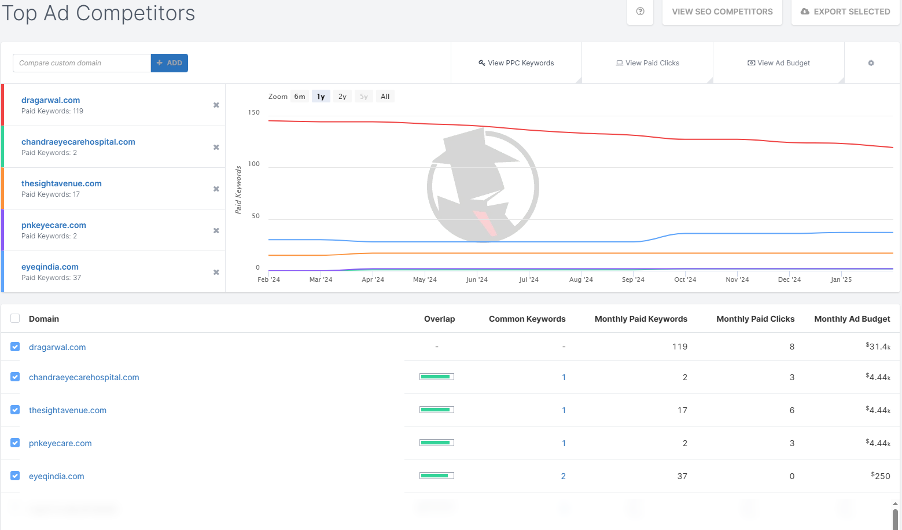

Slide 25
🔍 PPC (Paid Ads) Insights – dragarwal.com
📊 Key Metrics:
Paid Keywords: 119
Monthly Paid Clicks: 8
Monthly Ad Budget: $31.4k → High budget, but very low click volume (only 8 clicks!)
3.Competitor Comparison:
Other competitors like eyeqindia.com and chandraeyecarehospital.com spend around $250 to $4.4k/month, yet get 3–6 clicks.
They’re bidding on far fewer keywords (2–37), meaning their strategy is tightly focused and likely more efficient.
🧠 Observations
Low ROI from Google Ads:
With $31.4k monthly budget and just 8 clicks, the Cost per Click (CPC) is approximately $3,925 per click, which is extremely high unless these are extremely valuable conversion-focused clicks (e.g., high-end surgeries).
✅ Recommendations to Improve PPC Performance
1. Audit and Refine Keywords
Use only high-intent keywords like:
“LASIK surgery cost in [city]”
“best eye hospital near me”
“cataract operation Chennai”
Remove generic or low-converting terms.
2.Very Low Keyword-to-Click Efficiency:
Running ads on 119 keywords but receiving only 8 clicks means either:
Ads are not showing up (low impression share),
Ads have low CTR,
Or keywords are irrelevant/poorly targeted.
2. Use Location Targeting More Aggressively
Focus on specific cities/regions with nearby clinics.
Run geo-targeted campaigns to reduce budget waste.

Slide 26
3. Review Ad Copy and Extensions
Improve headline relevance, use emotional & trust-building phrases like:
“Trusted by 10 Million+ Patients”
“Book Free Eye Checkup”
“Affordable Cataract Surgery – EMI Available”
Add sitelink, callout, and location extensions.
6. Use Google Ads Recommendations
Regularly check the “Recommendations” tab in your Google Ads dashboard.
Google often suggests better bids, negative keywords, or ad strength improvements.
4. Landing Page Optimization
Ensure users land on dedicated service pages, not the homepage.
Use clear CTAs, testimonials, and trust signals (NABH, doctor profiles, patient success stories).
🔁 Bonus Tip: Coordinate SEO + PPC
If you already rank well for a keyword organically, don’t spend on it in PPC unless it's bringing high conversions. Focus PPC on keywords you're not ranking well for.
5. Test Remarketing Ads
Set up remarketing for visitors who bounced or didn’t convert.
Show them offers like free consultation, discount on LASIK, etc.

Slide 27
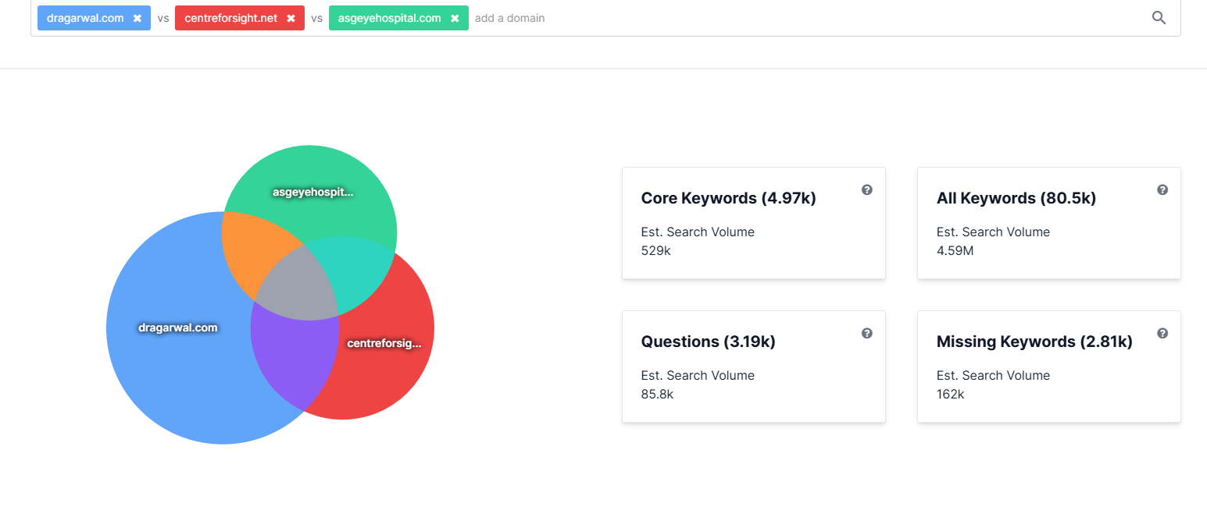

Slide 28
📊 Key Insights:
Category | Value | Meaning
Core Keywords | 4.97k | Keywords all 3 websites rank for (common area in Venn diagram)
All Keywords | 80.5k | Total keywords from all domains combined
Questions | 3.19k | Keywords in question form (e.g., “What is LASIK?”)
Missing Keywords | 2.81k | Keywords your competitors rank for but dragarwal.com does not
Est. Search Volume | 4.59M (total) | Huge traffic potential available across the space
 | 162k (missing kws) | Opportunity to capture relevant traffic your competitors already get

Slide 29
✅ Recommendations Based on This Data
1. Prioritize “Missing Keywords” (2.81k terms – 162k monthly searches)
You are not ranking for terms that competitors already are.
Action: Create pages/blogs targeting those specific keywords.
Example: If a competitor ranks for “glaucoma surgery in Mumbai”, make sure you have a location-optimized service page or blog post for it.
3. Competitive Edge Tip:
Your organic keyword pool is already strong, but you now know:
Which keywords competitors are using to get more traffic
Where your content blind spots are
4.Content Strategy Suggestions
Page Type | Purpose | Example Keyword
Service Pages | Rank for transactional keywords | “Cornea transplant in Bangalore”
Blog Articles | Educate + Rank for question keywords | “What to expect after LASIK?”
City Pages | Geo-targeted services | “Eye hospital in Hyderabad”
Comparison Posts | Compete with others directly | “Dr. Agarwal vs Center for Sight”
2. Target “Question-Based Keywords” (3.19k terms – 85.8k volume)
These are great for top-of-funnel traffic, especially through blogs, FAQs, or YouTube.
Examples:
“Is LASIK surgery safe?”
“How long is cataract recovery?”
“Best eye drops after surgery?”
Action: Start a Q&A-style blog series or video FAQ series to dominate this segment.

Slide 30
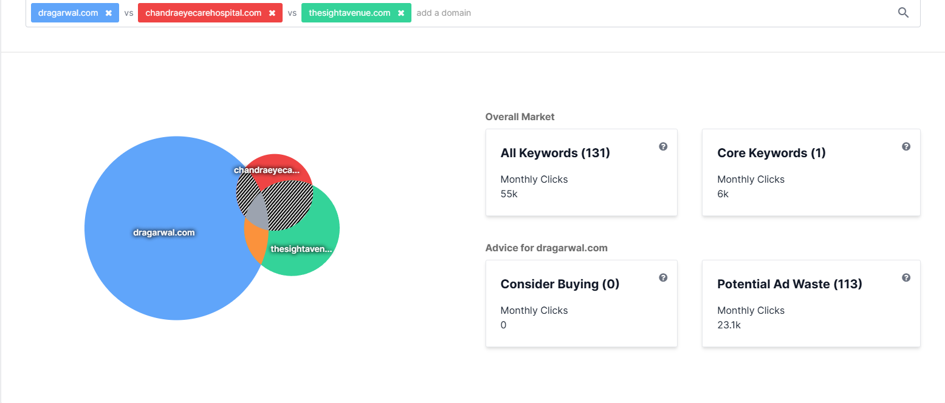

Slide 31
📊 Paid Keyword Market Analysis
Metric | Value | Meaning
All Keywords | 131 | Total keywords in the combined paid ad ecosystem
Core Keywords | 1 | Only 1 keyword is common across all 3 domains
Monthly Clicks (Overall) | 55k | Combined clicks from all paid ads
Consider Buying | 0 | No strong new paid keywords recommended to buy right now
Potential Ad Waste | 113 keywords (23.1k clicks) | dragarwal.com may be paying for irrelevant or poorly performing ads

Slide 32
🧠 Key Observations
1. Very High Potential Ad Waste
113 out of 119 paid keywords (from earlier screenshots) are possibly ineffective or wasting budget.
That’s ~95% inefficiency, which explains your extremely high CPC from earlier.
🎯 2. Focus on High-Intent, Location-Based Keywords
Prioritize keywords with actionable search intent, such as:
“LASIK eye surgery Bangalore price”
“Best eye doctor for cataract in Chennai”
“Book eye appointment Hyderabad”
2. Minimal Keyword Overlap with Competitors
Only 1 keyword overlaps between dragarwal.com, chandraeyecarehospital.com, and thesightavenue.com.
This suggests:
You might be bidding on broad, non-targeted terms
Competitors are using more focused, niche targeting
🛠 3. Reallocate Budget Wisely
Instead of spending $31.4k for 8 clicks (as shown earlier), cut budget waste and use remaining funds for:
Retargeting ads
Video ads showing patient testimonials
Call-only ads (especially for emergency or appointment bookings)
✅ Strategic Recommendations
🔧 1. Eliminate Low-Intent Paid Keywords
Review all 113 keywords flagged as potential ad waste.
Remove keywords that are:
Too broad (e.g., "eye care", "vision")
Not service-specific or conversion-focused
Generic without geo-targeting
✍️ 4. Use Competitor Intelligence
Since dragarwal.com has minimal overlap, consider:
Reverse-engineering competitor ads (e.g., thesightavenue.com)
Identify what keywords they are bidding on successfully
Craft better ad copies with stronger CTAs

Slide 33
🧪 5. A/B Test Ad Copy and Landing Pages
Use 2–3 variations of headlines, callouts, and descriptions.
Test landing pages optimized for different cities, services, or urgency-based offers.
🔁 Summary of Your PPC Issues & Fixes:
Problem | Fix
Low clicks despite high budget | Audit and pause irrelevant keywords
High CPC | Focus on geo + service keywords
Poor keyword targeting | Use competitor overlaps to find more relevant keyword ideas
No keywords to consider buying | Refresh keyword list using tools like SEMrush, Ahrefs, or Google Ads Keyword Planner
Potential ad waste | Build tighter, themed ad groups and match types (Exact/Phrase)

Slide 34
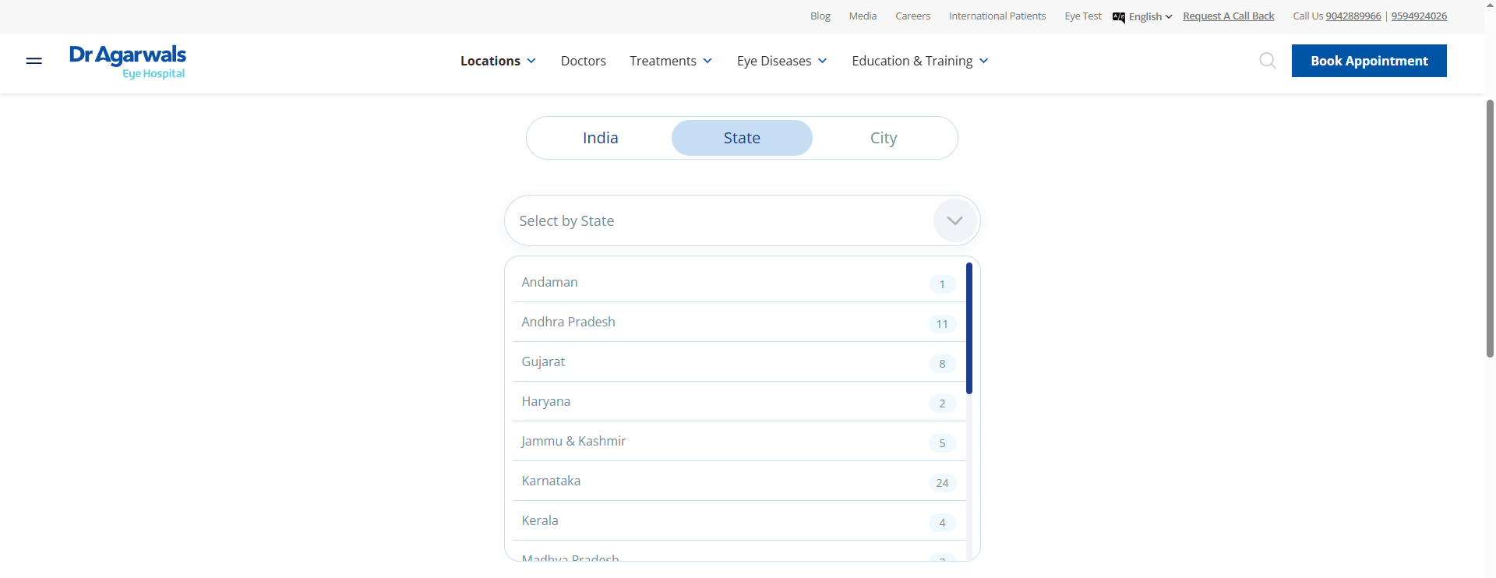
Operating locations / Geographic segmentation

Slide 35
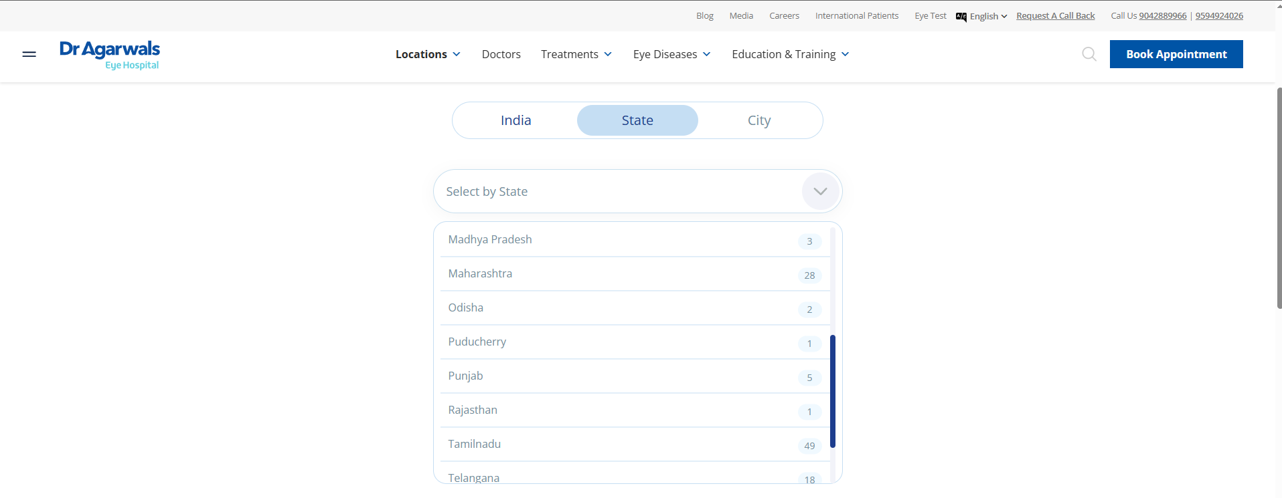

Slide 36
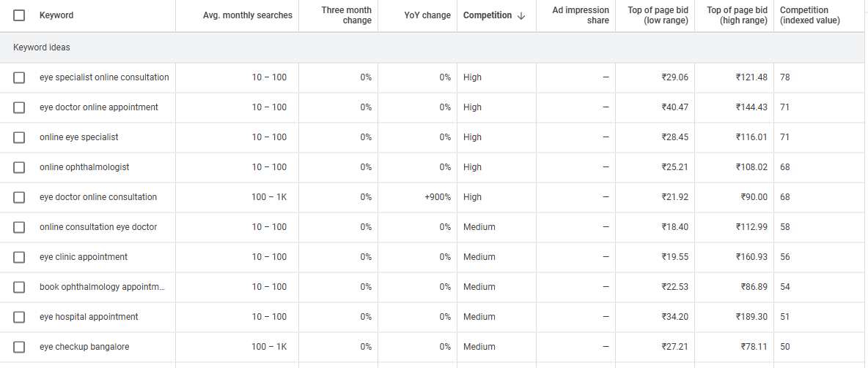
Keyword research

Slide 37
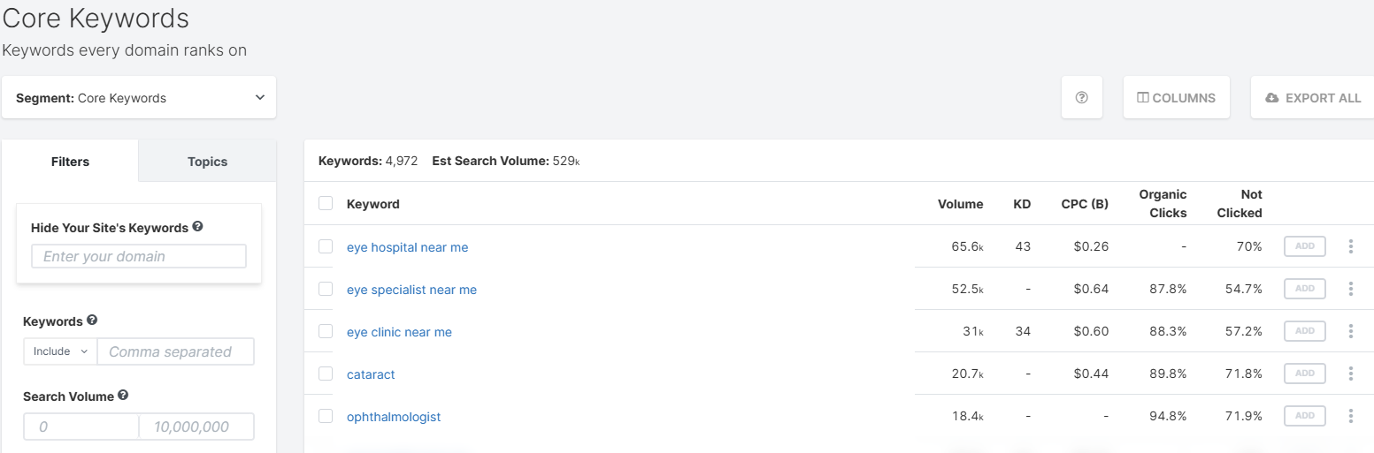
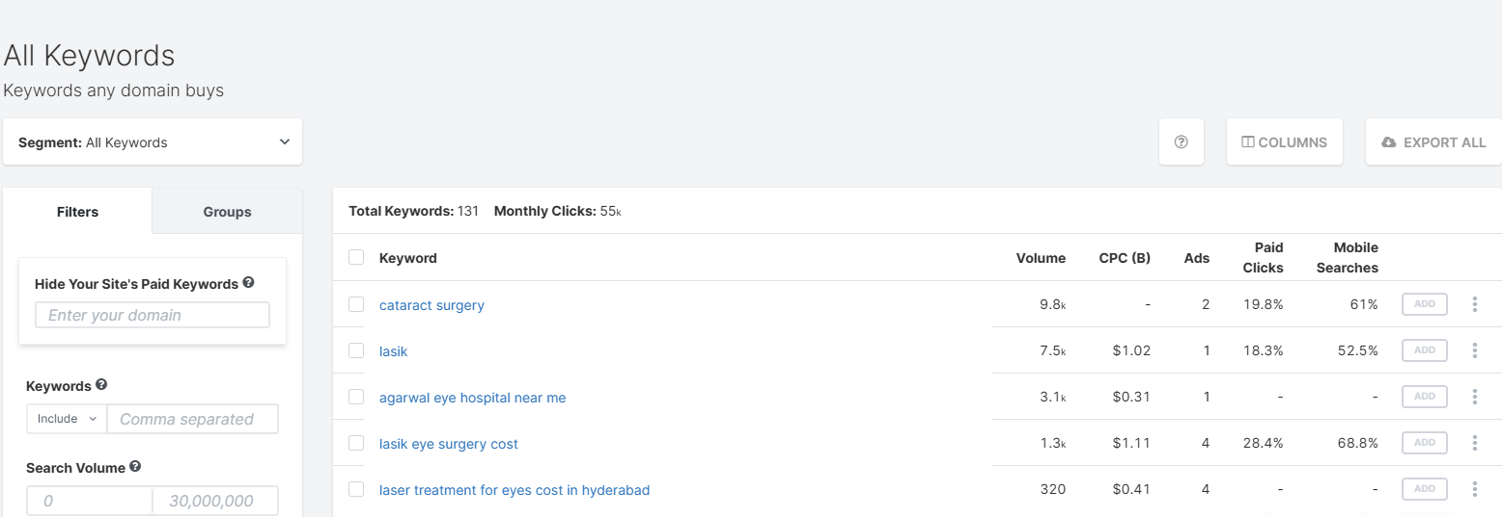

Slide 38
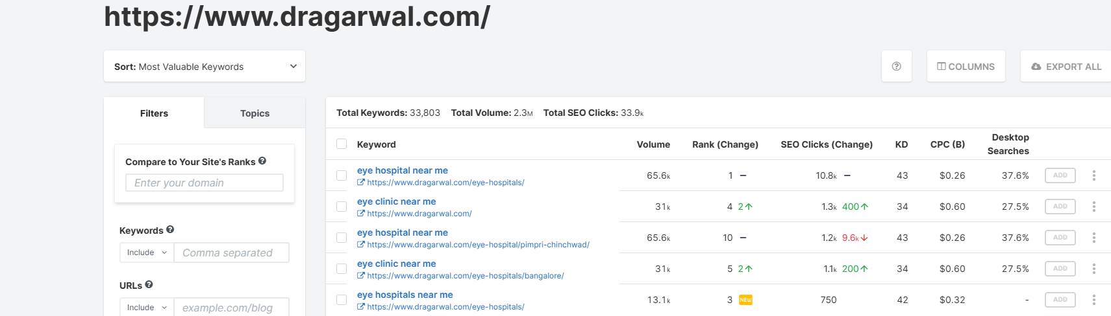
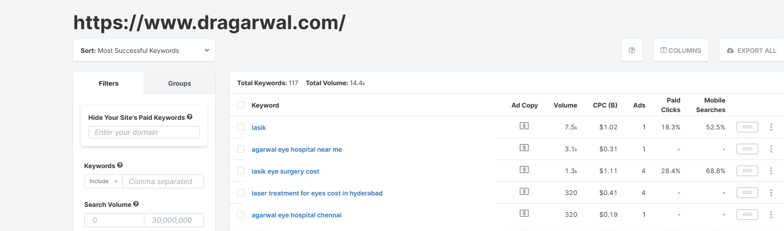

Slide 39
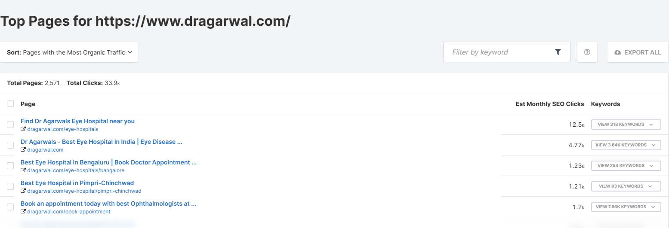

Slide 40
SEARCH ENGINE MARKETING
Goal
the ad plan we’ve put together for promoting Dr Agarwal’s Healthcare across India. The goal is to drive awareness and generate leads for your healthcare services in all the states where you operate.
Target Audience & Campaign Strategy
Target Audience: People looking for healthcare services such as eye care, surgery, and wellness solutions.Target users based on search queries related to these services.
Geographic Targeting: The company operates in multiple states, so run localized campaigns targeting each region specifically, adjusting budget based on the population and healthcare demand in each state

Slide 41
Budget Allocation
Assume a monthly budget of ₹500,000. We can allocate this budget across various states based on population and demand for healthcare services. Here’s an
breakdown:
Tamil Nadu: ₹75,000 (Highest demand, 49 locations)
Maharashtra: ₹60,000 (28 locations)
Karnataka: ₹50,000 (24 locations)
Telangana: ₹40,000 (18 locations)
Andhra Pradesh: ₹40,000 (11 locations)
Gujarat: ₹30,000 (8 locations)
Jammu & Kashmir: ₹15,000 (5 locations)
Kerala: ₹20,000 (4 locations)
Punjab: ₹15,000 (5 locations)
Madhya Pradesh: ₹10,000 (3 locations)
West Bengal: ₹10,000 (3 locations)
Rajasthan: ₹5,000 (1 location)
Other states: Allocate smaller budgets for other states as necessary.

Slide 42
Campaign Types
Search Campaigns: Focus on keywords like “eye care services,” “healthcare hospital near me,” “eye surgery,” etc. The goal is to capture intent-driven leads.
Display Campaigns: Use for brand awareness, especially in states with higher healthcare competition. Target users interested in health and wellness, medical services, etc.
YouTube Campaigns: Use video ads to promote healthcare services, educate users about treatments, and build brand credibility.
Expected Leads: Depending on the conversion rate (let’s assume 3%), you can expect the following:
For Search Campaigns: With an average CPC of ₹20 and ₹500,000 budget, you could expect approximately 10,000 clicks. With a conversion rate of 3%, this would lead to about 300 conversions (leads).
For Display Campaigns: The conversion rate will be lower, so expect fewer leads compared to search ads. Let’s estimate 1-2% conversion rate for display ads, leading to 50-100 leads.
Metrics & Estimations
Average CPC (Cost-Per-Click): Based on historical trends and the competitive nature of healthcare ads, expect an average CPC of ₹15 to ₹30 for search campaigns.
Cost per Conversion: Healthcare services, especially hospitals, tend to have a higher cost per conversion due to the competitive nature of the industry. An estimate for cost per conversion would be between ₹200 to ₹500, depending on the region.

Slide 43
State-Wise Campaign Breakdown
State | Budget Allocation | Estimated CPC (₹) | Expected Clicks | Conversion Rate | Expected Leads
Tamil Nadu | ₹75,000 | 20 | 3,750 | 3% | 113
Maharashtra | ₹60,000 | 25 | 2,400 | 3% | 72
Karnataka | ₹50,000 | 20 | 2,500 | 3% | 75
Telangana | ₹40,000 | 22 | 1,818 | 3% | 55
Andhra Pradesh | ₹40,000 | 20 | 2,000 | 3% | 60
Gujarat | ₹30,000 | 25 | 1,200 | 3% | 36
Jammu & Kashmir | ₹15,000 | 25 | 600 | 3% | 18
Kerala | ₹20,000 | 20 | 1,000 | 3% | 30
Punjab | ₹15,000 | 25 | 600 | 3% | 18
Madhya Pradesh | ₹10,000 | 25 | 400 | 3% | 12
West Bengal | ₹10,000 | 25 | 400 | 3% | 12
Rajasthan | ₹5,000 | 25 | 200 | 3% | 6
Other States | ₹45,000 | 20 | 2,250 | 3% | 68
Key Metrics Summary
Total Expected Clicks: ~20,000 clicks across all campaigns.
Total Expected Leads: ~600 leads from all campaigns, with a higher contribution from search campaigns.

Slide 44
Recommendations for Best Performance
Focus on High-Conversion States: Prioritize Tamil Nadu, Maharashtra, and Karnataka, as they have the highest number of locations and larger populations.
Use Remarketing: For better ROI, use remarketing campaigns for users who have already visited the website or interacted with previous ads.
Adjust Bidding: Use bid adjustments based on device, location, and time of day to optimize for higher-performing segments.
Monitor & Optimize: Track performance daily and adjust bids, keywords, and targeting to maximize the budget’s efficiency.

Slide 45
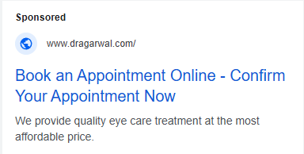
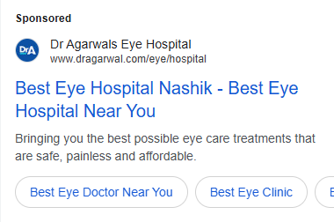
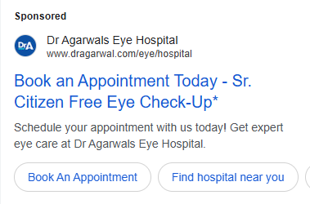
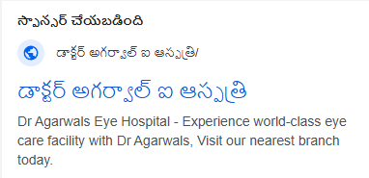
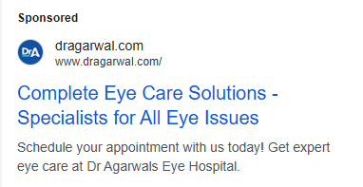
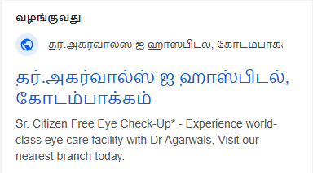
GOOGLE ADS / TEXT ADS

Slide 46
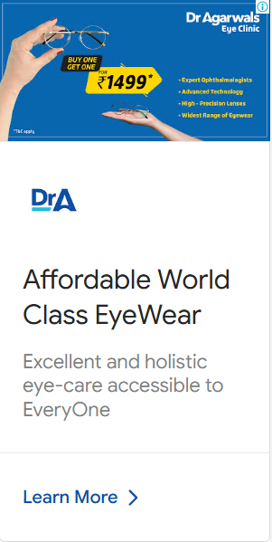
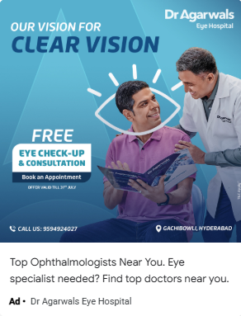
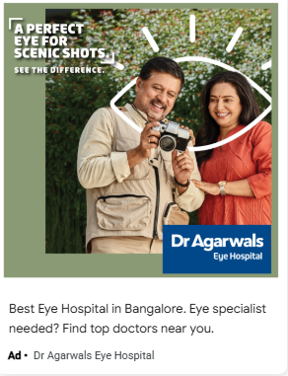
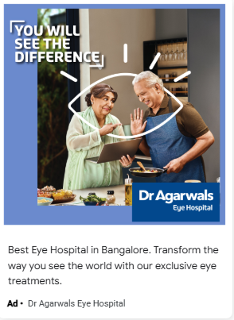
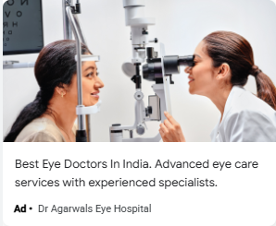
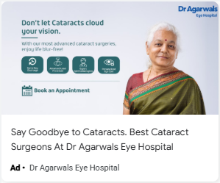
IMAGE ADS

Slide 47
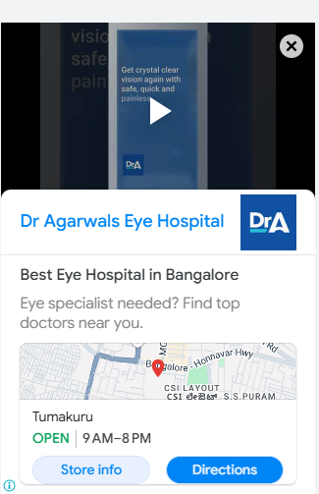
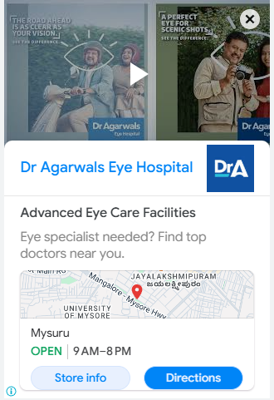
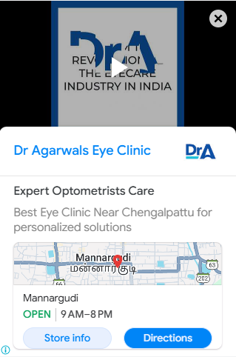
Video ads

Slide 48
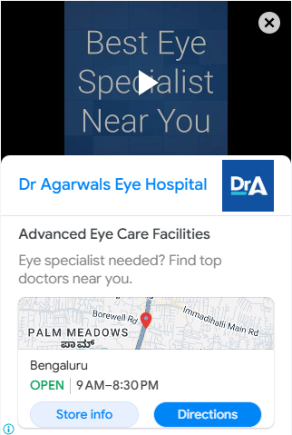
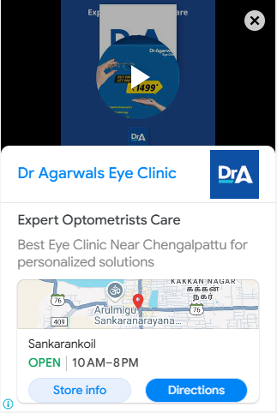
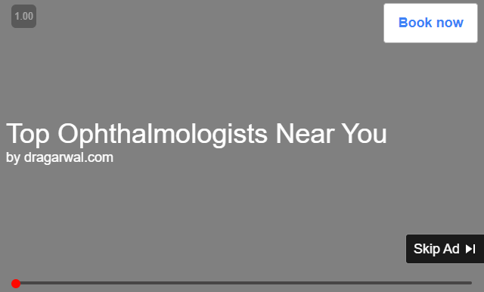

Slide 49
Social media marketing
Campaign Strategy:
To effectively promote Dr Agarwal’s Healthcare across India, we’ll be running Lead Generation and Brand Awareness campaigns on Facebook and Instagram. This will help us build awareness, engage with potential patients, and drive conversions.
Lead Generation Campaigns:
These will focus on driving direct conversions by encouraging users to fill out forms directly on the platform. This allows us to gather potential patient details for follow-up.
Brand Awareness Campaigns:
These campaigns will showcase the various services offered, such as eye care, vision correction, and cataract surgery, using engaging ad formats like carousel ads, video ads, and single-image ads. The goal is to increase visibility, educate the audience about Dr Agarwal’s services, and capture interest from people who may not be actively searching but are interested in healthcare services.

Slide 50
Target Audience:
We’ll segment the audience based on:
Demographics: Age, gender, and location.
Interests: People interested in healthcare, eye care, wellness, and medical treatments.
Behaviors: Individuals who have previously searched for eye care or healthcare-related services.
Custom Audiences: We can also target people who have already visited the website or interacted with previous ads (remarketing).

Slide 51
Budget Allocation:
The overall budget will be ₹500,000 per month, which will be split across the states based on demand, population, and the number of Dr Agarwal's locations in each region.
State | Budget Allocation (₹) | Estimated CPC (₹) | Expected Clicks | Conversion Rate | Expected Leads
Tamil Nadu | ₹80,000 | ₹12 | 6,667 | 3% | 200
Maharashtra | ₹60,000 | ₹15 | 4,000 | 3% | 120
Karnataka | ₹50,000 | ₹12 | 4,167 | 3% | 125
Telangana | ₹40,000 | ₹13 | 3,077 | 3% | 92
Andhra Pradesh | ₹40,000 | ₹11 | 3,636 | 3% | 109
Gujarat | ₹30,000 | ₹16 | 1,875 | 3% | 56
Jammu & Kashmir | ₹15,000 | ₹17 | 882 | 3% | 26
Kerala | ₹20,000 | ₹12 | 1,667 | 3% | 50
Punjab | ₹15,000 | ₹15 | 1,000 | 3% | 30
Madhya Pradesh | ₹10,000 | ₹17 | 588 | 3% | 18
West Bengal | ₹10,000 | ₹17 | 588 | 3% | 18
Rajasthan | ₹5,000 | ₹18 | 278 | 3% | 8
Other States | ₹45,000 | ₹13 | 3,461 | 3% | 104

Slide 52
Ad Formats & Creative Strategy:
Carousel Ads:
These ads will showcase the different services Dr Agarwal’s offers, like eye exams, cataract surgery, and advanced treatments. This will allow users to swipe through multiple services, increasing engagement.
Video Ads:
Short, engaging videos that explain the benefits of eye care, share patient testimonials, or highlight the expertise of the doctors and medical staff. These ads will build trust and credibility for the brand.
Single-Image Ads:
Eye-catching images of the clinics, medical professionals, and patients. These ads will have clear calls-to-action like "Book an Appointment" or "Get a Free Consultation."
Lead Ads:
Using Meta’s lead generation forms, users will be able to submit their information directly within the platform, which reduces friction and makes it easier for potential patients to convert.

Slide 53
Optimization and Tracking:
A/B Testing:
We will test different creatives, ad formats, and copy to determine what works best and optimize for better results over time.
Retargeting:
We'll retarget users who have interacted with our ads or visited the website but haven’t converted. This will help us capture leads that might have been missed initially.
Geo-Targeting:
We'll specifically target users in regions where Dr Agarwal has a presence, ensuring that ads are shown to people in the right locations.
Lookalike Audiences:
Meta’s lookalike audiences feature will allow us to target users similar to those who have already converted, increasing the chances of reaching people likely to book an appointment.
Expected Results:
With a monthly budget of ₹500,000, we can expect to generate around 1,000 to 1,200 leads across India.

Slide 54
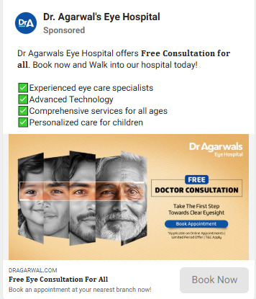
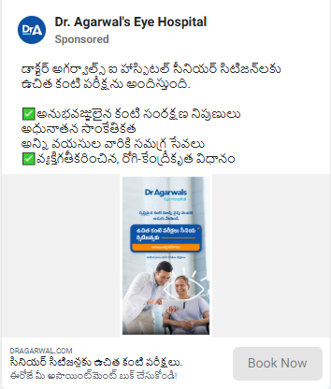
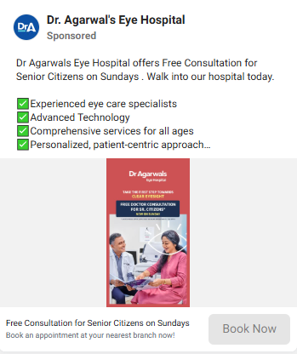
Meta ads / single image

Slide 55
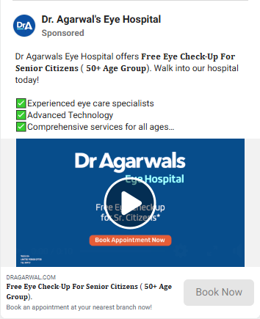
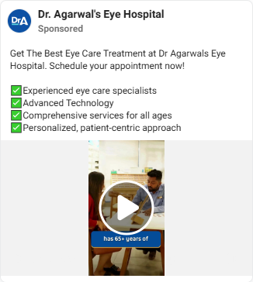
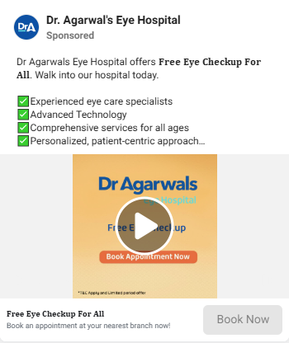
video ads

Slide 56
Influencer marketing
Objective:
The main goal of this influencer marketing campaign is to increase awareness of Dr Agarwal’s Eye Hospital, promote healthcare services, and drive conversions. With Sachin Tendulkar being the face of the brand, we aim to leverage his massive following and credibility to build trust, drive engagement, and attract more patients.
Target Audience:
Age Group: 30-60 years, with a focus on people who are more likely to need eye care services (cataract treatment, vision correction, etc.)
Location: Target major metropolitan cities where Dr Agarwal’s Eye Hospital operates, including Tamil Nadu, Maharashtra, Karnataka, and others.
Demographics: Middle to upper-income groups who are interested in healthcare, wellness, and value expert medical treatment.

Slide 57
Key Components of the Campaign:
Content Creation with Sachin Tendulkar:
Videos: Sachin can create short, engaging videos talking about the importance of eye care, maintaining good eyesight, and how Dr Agarwal’s Eye Hospital offers top-notch services. These videos can be used on platforms like Instagram, Facebook, and YouTube.
Example Video Script: "As someone who relies on precision and vision for my game, I trust Dr Agarwal’s Eye Hospital for their expertise in eye care. They’ve been providing quality treatment for years, and I encourage everyone to take the first step toward clear eyesight today. Book your consultation now."
Instagram Stories/Reels: Short clips of Sachin visiting the hospital or using the hospital’s services (such as consultation or eye checkups) can be posted as part of Instagram Stories or Reels to engage younger audiences.
Sachin could also share a personalized message encouraging people to get a free consultation for senior citizens, making the offer more appealing.
Testimonial Posts: Sachin can post a series of static image posts showing his personal endorsement, talking about the hospital's services, or sharing a success story with Dr Agarwal’s healthcare. The posts can be paired with before-and-after photos, showcasing how vision correction can improve quality of life.

Slide 58
2.Hashtag Campaign:
#ClearVisionWithSachin or #TakeTheFirstStep can be used as a campaign hashtag, encouraging followers to share their eye health journey or book consultations at Dr Agarwal’s Eye Hospital. This can increase engagement and spread the word through user-generated content.
3.Social Media Shoutouts:
Sachin Tendulkar can post on his personal social media accounts about the collaboration with Dr Agarwal’s Eye Hospital. This can include a combination of posts on Facebook, Instagram, Twitter, and LinkedIn, reaching his vast follower base across all platforms.
Example: “I trust Dr Agarwal’s Eye Hospital with my eye care needs. Book your free consultation today!”
4.Paid Campaigns with Sachin as Brand Ambassador:
Running Facebook and Instagram ads featuring Sachin promoting specific services like cataract surgery, eye checkups, or free consultations for senior citizens. The ad visuals would showcase Sachin with a call-to-action (CTA) to book appointments, encouraging the audience to act immediately.
Targeting: The ads will specifically target people who have interests in health, wellness, and sports (for younger audiences). They can also be tailored to senior citizens for specific promotions.
5.Discounts and Exclusive Offers:
A limited-time discount or an exclusive offer can be tied to Sachin’s promotion, such as “Book a consultation with Dr Agarwal’s Eye Hospital and get a discount on your first treatment.”
A special offer for senior citizens, featuring Sachin’s personal endorsement, can be promoted to encourage elderly patients to take action.

Slide 59
Platform Strategy:
Instagram:
Instagram is an ideal platform for influencer marketing due to its visual nature and younger audience. Sachin’s posts can include high-quality photos, video testimonials, and Stories/Reels featuring him in the clinic or discussing eye care.
Engagement: Use polls, questions, and swipe-up links in Instagram Stories to direct traffic to booking pages.
Facebook:
Facebook’s large user base, especially among older demographics, will be key for targeting senior citizens and families who might be looking for eye care services. Sachin can promote Facebook-exclusive offers such as “Free consultation for senior citizens” and share videos with a CTA to book appointments.
Facebook Ads: Run sponsored content of Sachin’s posts to reach a wider audience, particularly in targeted geographic regions.
YouTube:
Long-form video content where Sachin can explain the importance of eye health and discuss his personal experience with Dr Agarwal’s Eye Hospital.
Video series on eye care tips, with Sachin as the host, could be created in collaboration with YouTube influencers or doctors associated with the hospital to drive awareness.

Slide 60
Metrics for Success:
Engagement Rates: Track the engagement on posts made by Sachin, including likes, comments, shares, and click-through rates (CTR).
Lead Generation: Measure the number of leads generated from Instagram Stories, Facebook posts, and ads featuring Sachin. This could be tracked via a custom landing page or unique campaign codes.
Brand Sentiment: Monitor how people are reacting to the campaign, including positive mentions, hashtags used by followers, and the general sentiment around Dr Agarwal’s Eye Hospital during the campaign.
Conversion Rate: Track the number of consultations booked, particularly for senior citizens, in response to the campaign offers.
Budget Considerations:
Influencer Fees: Sachin Tendulkar’s fees for promoting the brand can be significant, so allocate a portion of the budget for this, ensuring you get high visibility.
Paid Ads: A substantial part of the budget will go towards Facebook and Instagram ads featuring Sachin to boost reach, especially targeting users who are likely to book consultations.
Creative Production: Budget for creating high-quality content, including professional video and photography shoots with Sachin.
Timeline:
Week 1: Pre-launch phase. Announcement of Sachin Tendulkar’s collaboration with Dr Agarwal’s Eye Hospital.
Week 2–4: Full launch. Sachin starts posting on social media and promoting services via video content, Instagram Stories, and Facebook posts.
Ongoing: Continuous engagement with followers through Instagram Stories and Twitter. Retargeting ads based on user interactions.

Slide 61
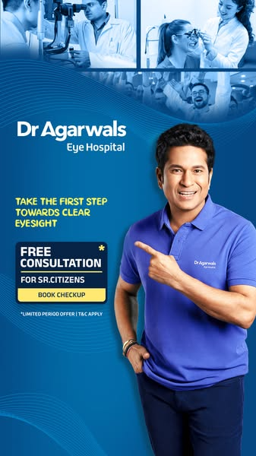
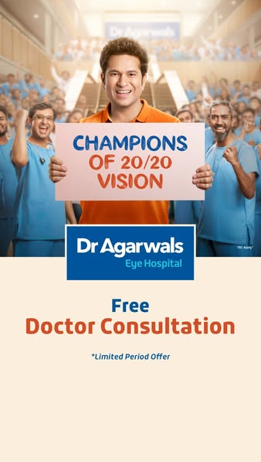
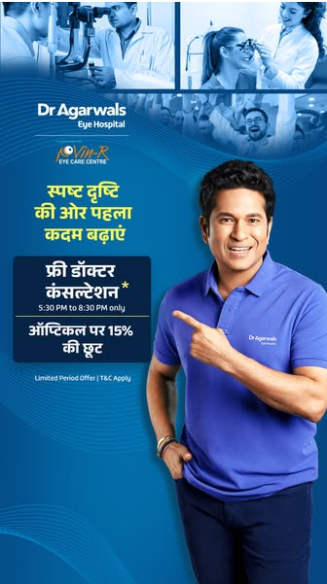
Influencer endorsements

Slide 62
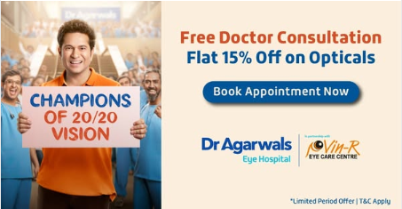
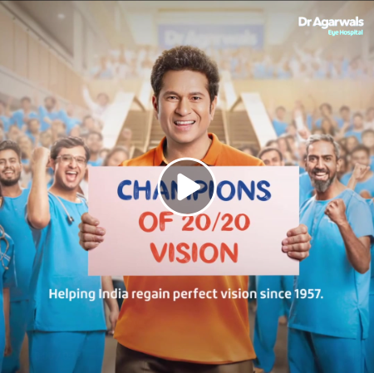
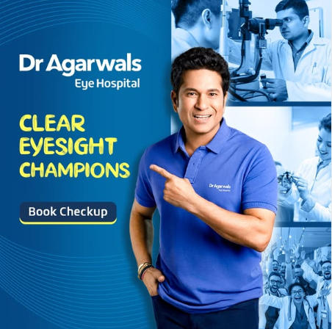

Slide 63
Email marketing
Objective:
The goal of this email marketing campaign is to:
Drive awareness about the various services offered by Dr Agarwal’s Eye Hospital (e.g., cataract surgery, eye checkups, vision correction).
Encourage recipients to book consultations and treatments.
Keep existing patients engaged with updates, offers, and health tips.
Target Audience:
Potential Patients: Individuals looking for eye care services like cataract surgery, vision correction, or general eye checkups.
Existing Patients: People who have already received treatment or consultations at Dr Agarwal’s Eye Hospital. Follow-ups to encourage repeat visits or regular eye checkups.
Senior Citizens: Special offers or discounts for seniors to encourage them to get eye care services.
Geographic Targeting: People residing in cities and regions where Dr Agarwal’s Eye Hospital has branches.

Slide 64
Email Campaign Types:
Welcome Emails:
Goal: Introduce Dr Agarwal’s Eye Hospital to new subscribers and build brand awareness.
Content:
Introduction to Dr Agarwal’s history and services.
Highlight key treatments like cataract surgery, vision correction, and advanced eye care technologies.
CTA: Book a free consultation or an eye checkup.
Educational Emails:
Goal: Educate potential patients on the importance of eye health and the various services Dr Agarwal’s offers.
Content:
Information on common eye conditions (e.g., cataracts, glaucoma).
Benefits of regular eye checkups.
Treatment options at Dr Agarwal’s.
CTA: Schedule an eye test or consultation.

Slide 65
3.Promotional Emails:
Goal: Drive immediate conversions by offering special discounts or time-limited offers.
Content:
Special offers for senior citizens (e.g., free consultations for a limited period).
Discounts on treatments like cataract surgery, LASIK, etc.
Use Sachin Tendulkar’s endorsement if available for more credibility.
CTA: Book now or get a free consultation.
4.Testimonial and Success Story Emails:
Goal: Build trust by sharing patient success stories or testimonials.
Content:
Share real-life patient testimonials that highlight positive experiences and successful treatments.
Include before-and-after photos if available.
CTA: Read more success stories or book a consultation to experience the results firsthand.
5.Follow-Up Emails (Post Consultation):
Goal: Nurture relationships with existing patients and encourage regular checkups or follow-up appointments.
Content:
A thank-you note for choosing Dr Agarwal’s Eye Hospital.
Tips for maintaining eye health after the treatment.
Reminder to schedule regular eye checkups.
CTA: Book your follow-up appointment.

Slide 66
6.Seasonal/Reminder Emails:
Goal: Encourage patients to book appointments or take action during specific seasons or based on health needs.
Content:
Seasonal reminders like “Prepare for summer – Protect your eyes from UV damage.”
Year-end health checkups or reminder for annual eye exams.
Offer for the holiday season or new year (e.g., “Start the year with clearer vision”).
CTA: Book a seasonal eye checkup.

Slide 67
Email Structure:
Subject Line:
Keep it short, clear, and personalized to grab attention.
Example: “Get Your Clear Vision Back – Book a Free Consultation Now!”
Personalized Greeting:
Use the recipient’s name to create a personal connection.
Example: “Hi [Name], we’re excited to help you with your eye care needs!”
Compelling Visuals:
Include high-quality images of the hospital, doctors, happy patients, and relevant eye care treatments.
Add a short video from Dr Agarwal’s or Sachin Tendulkar endorsing the services (if applicable).
Clear Call-to-Action (CTA):
Each email should have a clear CTA to encourage immediate action.
Example: “Book your consultation now” or “Learn more about our treatments”.
5.Contact Information & Social Proof:
Include hospital contact information and links to social media profiles for trust and credibility.
Include positive reviews or ratings if available.

Slide 68
Frequency of Emails:
Welcome Email: Sent immediately after subscription.
Educational Emails: Bi-weekly or monthly, depending on the need for information.
Promotional Emails: As needed (e.g., limited-time offers, festive discounts, etc.).
Testimonial Emails: Monthly or quarterly to maintain engagement.
Follow-Up Emails: A week after the consultation, then quarterly for regular checkups.
Seasonal Emails: Sent based on key dates (e.g., seasonal health tips, new year offers).
Segmentation Strategy:
To improve engagement, we will segment the email list based on the following criteria:
New Subscribers vs. Existing Patients:
Tailor the messaging to new subscribers, introducing them to the hospital’s services.
For existing patients, focus on follow-up care, reminders, and loyalty offers.
Geographic Location:
Send region-specific emails based on where the recipient is located (e.g., promote the nearest Dr Agarwal branch).
Interest-Based Segmentation:
Segment users by the services they’re interested in, such as cataract surgery, LASIK, or general eye checkups, and tailor the content accordingly.

Slide 69
Metrics to Track:
Open Rate:
Monitor the open rates to assess how engaging your subject lines are and how effectively you're reaching your audience.
Click-Through Rate (CTR):
Track the percentage of people clicking on the CTA to gauge the effectiveness of the content and the design of your emails.
Conversion Rate:
Track the number of leads generated (booked consultations, treatments) as a result of the email campaign.
Unsubscribe Rate:
Keep an eye on how many recipients unsubscribe to assess how well your content resonates with the audience.
Bounce Rate:
Monitor how many emails fail to reach recipients and refine your email list regularly.
Tools to Use:
Email Marketing Platforms: Use platforms like Mailchimp, HubSpot, or SendGrid to automate and manage your email campaigns effectively.
Analytics Tools: Use tools like Google Analytics and built-in email analytics to track the success of the email campaigns and optimize accordingly.

Slide 70


Welcome Email:
Educational Email:

Slide 71


Promotional Email:
Success story Email:

Slide 72


Follow-Up Email:
Seasonal Email:

Slide 73
CONTENT CALENDAR
Day | Date | Post Type | Topic/Content | Platform
1 | Mon | Awareness | “Did you know? 80% of vision impairment is preventable.” | Facebook, Instagram
2 | Tue | Educational Carousel | 5 Signs You Might Need an Eye Check-Up | Instagram, LinkedIn
3 | Wed | Doctor's Tip | Dr. [Name] shares daily eye care tips | Instagram Stories
4 | Thu | Testimonial | Real Patient Story: “I got my vision back after cataract surgery.” | Facebook, YouTube
5 | Fri | Myth Buster | “Myth: LASIK is painful. Truth: It’s painless & quick!” | Instagram, Twitter
6 | Sat | Staff Feature | Meet the Team: Highlight of an optometrist or nurse | LinkedIn, Instagram
7 | Sun | Community Engagement | Poll: “How often do you get your eyes checked?” | Instagram Stories
8 | Mon | Promo Post | Special Discount on Eye Check-up this Month! | Facebook, Instagram
9 | Tue | Educational Video | How does cataract surgery work? (Animated explainer) | YouTube, Instagram
10 | Wed | FAQ | “Is LASIK safe?” – Answering common patient questions | Facebook, Website Blog
11 | Thu | Behind the Scenes | Glimpse of our operation theatre & hygiene protocols | Instagram Reels
12 | Fri | Awareness Day Post | World Glaucoma Week: What you need to know | Facebook, Twitter
13 | Sat | Quiz Day | Eye Health Quiz: “What’s 20/20 vision?” | Instagram Stories
14 | Sun | Fun Fact | “Your eyes blink about 20 times every minute.” | Instagram, Twitter
15 | Mon | Patient Education | Understanding Diabetic Retinopathy | YouTube, LinkedIn
16 | Tue | Service Spotlight | Retina Care Services – What We Offer | Website, Facebook
17 | Wed | Instagram Reel | “A Day in the Life of an Eye Surgeon” | Instagram, YouTube
18 | Thu | Testimonial | Video testimonial from a LASIK patient | YouTube Shorts, Instagram
19 | Fri | FAQ | “Can children wear contact lenses?” | Facebook, LinkedIn
20 | Sat | Interactive Poll | “Do you wear glasses or contacts?” | Instagram Stories
21 | Sun | Eye Exercise Tips | 20-20-20 Rule to prevent digital eye strain | Instagram, Facebook
22 | Mon | Promo Reminder | 1 Week Left: Avail 20% off Eye Screening | Facebook, Instagram
23 | Tue | Festival Post | Holi Safety Tips: Protect Your Eyes During Festivals | Instagram, Facebook
24 | Wed | Doctor Quote | Inspirational Quote from Chief Surgeon | LinkedIn, Instagram
25 | Thu | Patient Journey | From Consultation to Recovery – LASIK Story | YouTube, Facebook
26 | Fri | Infographic | Cataract vs Glaucoma – What’s the Difference? | Instagram Carousel
27 | Sat | “Did You Know?” | Fun Eye Fact: “The eye can focus on 50 different objects every second.” | Instagram, Twitter
28 | Sun | Ask Me Anything (AMA) | Doctor answers LIVE questions on IG/FB | Instagram Live, Facebook
29 | Mon | Feedback Request | “We love to hear from you! Share your experience.” | Facebook, WhatsApp
30 | Tue | Monthly Recap Video | Highlights of surgeries, testimonials, tips, and events this month | YouTube, Instagram Reel

Slide 74
Monthly Website Promotion Budget – Dr. Agarwal’s Eye Hospital (₹500,000)
Channel | Budget % | Monthly Budget (₹) | Justification
Google Ads (Search & Display) | 30% | ₹150,000 | • High search intent; avg CPC ₹15–₹30 • 99% of traffic is organic – paid underused • Potential ~10,000 clicks & 300 leads/month
Meta Ads (FB/Instagram) | 25% | ₹125,000 | • Lead form ads reduce friction • Expected 1,000–1,200 leads/month • Carousel/video ads improve engagement
YouTube Ads | 10% | ₹50,000 | • Builds trust via education • Great for awareness, lower conversions • Use influencer/patient testimonial videos
Influencer Marketing (Sachin) | 15% | ₹75,000 | • Leverages Sachin’s credibility • Campaign hashtags + mass reach • Drives awareness & senior consultations
SEO (Organic Optimization) | 10% | ₹50,000 | • 99% of traffic from SEO • Dip in SEO clicks needs fixing • Target high-intent keywords, improve CTAs
Email Marketing | 5% | ₹25,000 | • Ideal for follow-ups & seasonal offers • High ROI, low cost • Encourages repeat visits & loyalty
Content Creation (Blogs, FAQs) | 5% | ₹25,000 | • Create blogs, success stories, FAQs • Boosts SEO + trust • Supports email & organic campaigns

Slide 75

Thank you
Kamalesh K
DIGITAL MARKETER
kamaleshk1011@gmail.com
https://www.linkedin.com/in/kamalesh10/

